Slide 1
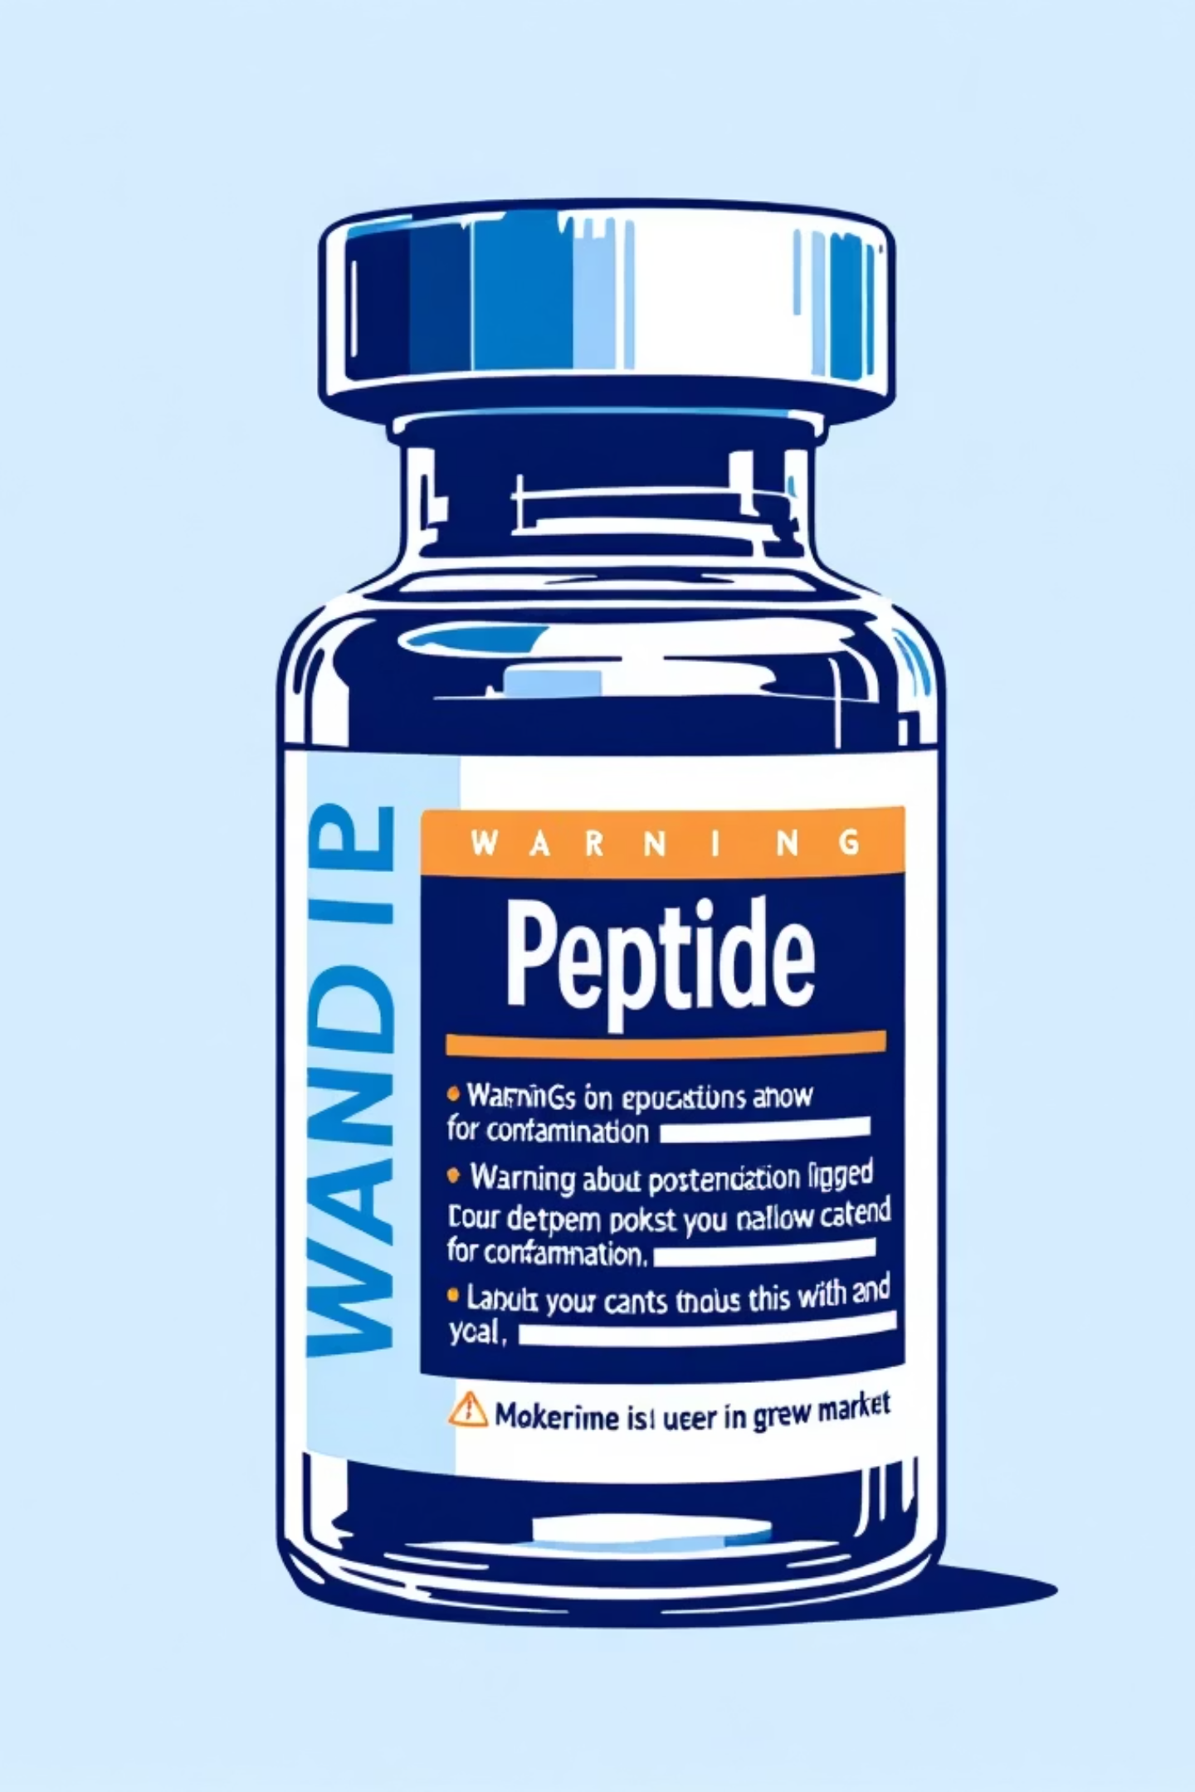


FDA Enforcement Actions & Regulatory Insights on Peptides
What You Need to Know
A comprehensive guide for Compliance Investigators navigating the complex regulatory landscape of peptide enforcement
Compliance Insight, Inc., 2026

Slide 2


The Rising Concern: Peptides in the Regulatory Spotlight
Regulatory Classification
Safety Risks Identified
Peptides under 40 amino acids are regulated as drugs; longer chains are biologics requiring special licenses
FDA identifies significant safety risks with many compounded peptides lacking sufficient safety data (e.g., BPC-157, Cathelicidin LL-37)
Grey Market Concerns
"Grey market" peptides often sourced internationally, sold without FDA approval, pose contamination and safety risks
The FDA's heightened focus on peptides reflects growing concerns about patient safety and market integrity
“FDA will take swift action against companies mass-marketing illegal copycat drugs, claiming they are similar to FDA-approved products."
— Dr. Marty Makary, FDA Commissioner
Compliance Insight, Inc., 2026

Slide 3
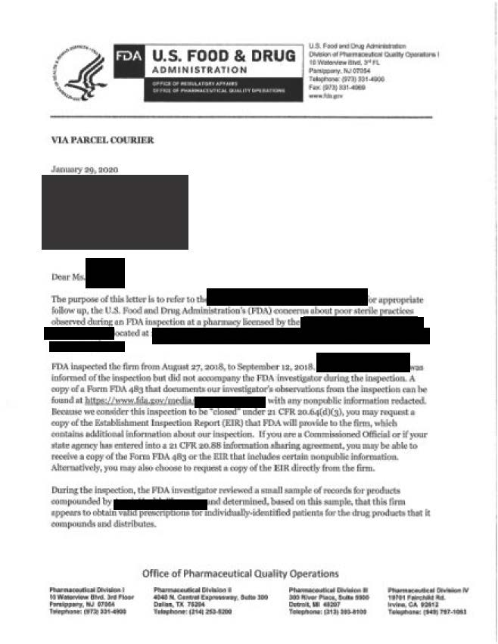
Recent FDA Warning Letters Targeting Peptide Sellers
High-Profile Enforcement Actions
Many Compounding Pharmacies sold unapproved GLP-1 analogs like Semaglutide, Tirzepatide with therapeutic claims despite "research use only" disclaimers
Several 503A and 503B Compounding Pharmacies owned by the same parent company found themselves the target of FDA review.
FDA emphasizes disclaimers like "not for human use" are often a ruse to evade regulation
FDA Green List
2025 Enforcement Statistics
31 Form 483s to Compounding Pharmacies
50+ Warning Letters issued and 1 Untitled Letter posted
Labeling siting therapeutic uses were the most common Warning Letter trigger.
View FDA Compounding Inspections & Actions Database
Compliance Insight, Inc., 2026

Slide 4

FDA's Regulatory Framework for Peptide Compounding
01
Approved Sources Only
Only peptides that are FDA-approved, GRAS, have USP monographs, or appear on the 503A or 503B Bulks List may be compounded
02
Biologics Licensing Requirements
Peptides classified as biologics require a biologics license, which 503A pharmacies
cannot obtain
03
API Sourcing Standards
Pharmaceutical-grade APIs must be sourced from FDA-registered manufacturers with comprehensive Certificates of Analysis
04
Research-Only Prohibition
"Research use only" peptides are strictly prohibited for human or animal use
Compliance Insight, Inc., 2026

Slide 5
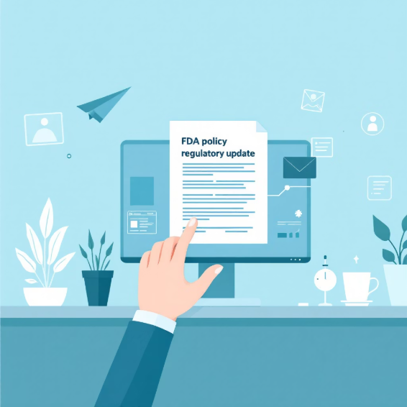

Enforcement Discretion & Recent Policy Updates
1
2
3
GLP-1 Enforcement Shift
503B Grace Period
Ongoing Monitoring
FDA's enforcement discretion for compounded semaglutide and tirzepatide ended in early 2025 after drug shortages resolved
Outsourcing facilities (503B) have a grace period but face enforcement for quality or safety violations
FDA continues to monitor compounded peptides for substandard quality, improper labeling, and unsafe practices
Critical Policy Change: The end of enforcement discretion marks a significant shift in FDA's approach to GLP-1 peptide compounding
Compliance Insight, Inc., 2026

Slide 6
Best Practices for Compliance Insight
Handling Peptide Questions
Verify Regulatory Status
Confirm Sourcing
Scrutinize Claims
Is it FDA-approved or on the 503A/B Bulks List? Is it a biologic requiring special licensing? What are the state regulations?
Ensure APIs are pharmaceutical grade from FDA-registered Supplier. If from a foreign Supplier the manufacturer is on the FDA Green List
Watch for therapeutic claims or marketing that imply human use despite "research use only" disclaimers
Assess Facility Compliance
Educate Providers
Check for proper licensing, recordkeeping, staff training, and adherence to USP standards
Guide healthcare providers on legal risks of using unapproved peptides and compliant alternatives
Compliance Insight, Inc., 2026

Slide 7
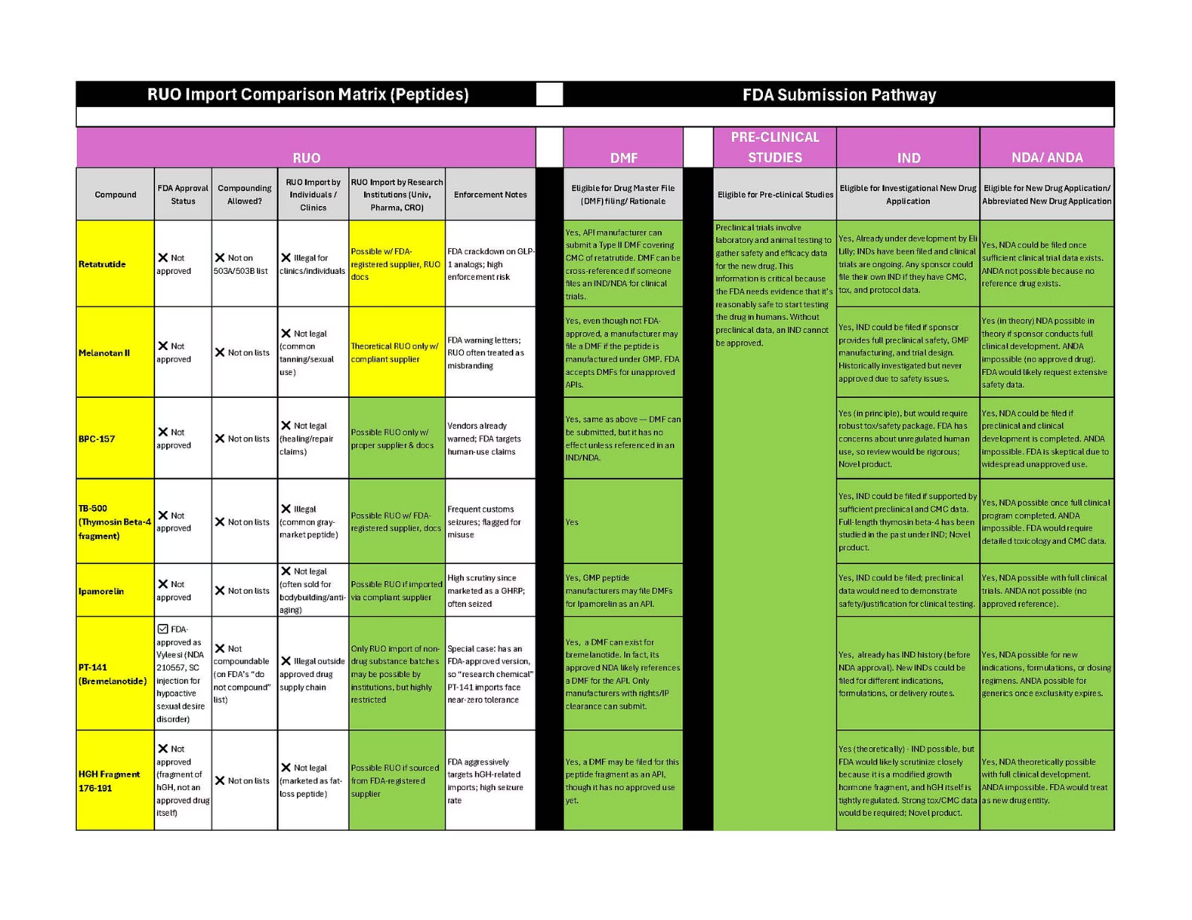
Illegal Peptide Active Ingredients
Many companies are selling RUO Peptides illegally
RUO products are sold to laboratories, universities and research organizations
Alternate routes are DMF which feeds into IND/ANDA/BLA/NDA
The seller is responsible for the end user use
Compliance Insight, Inc., 2026

Slide 8
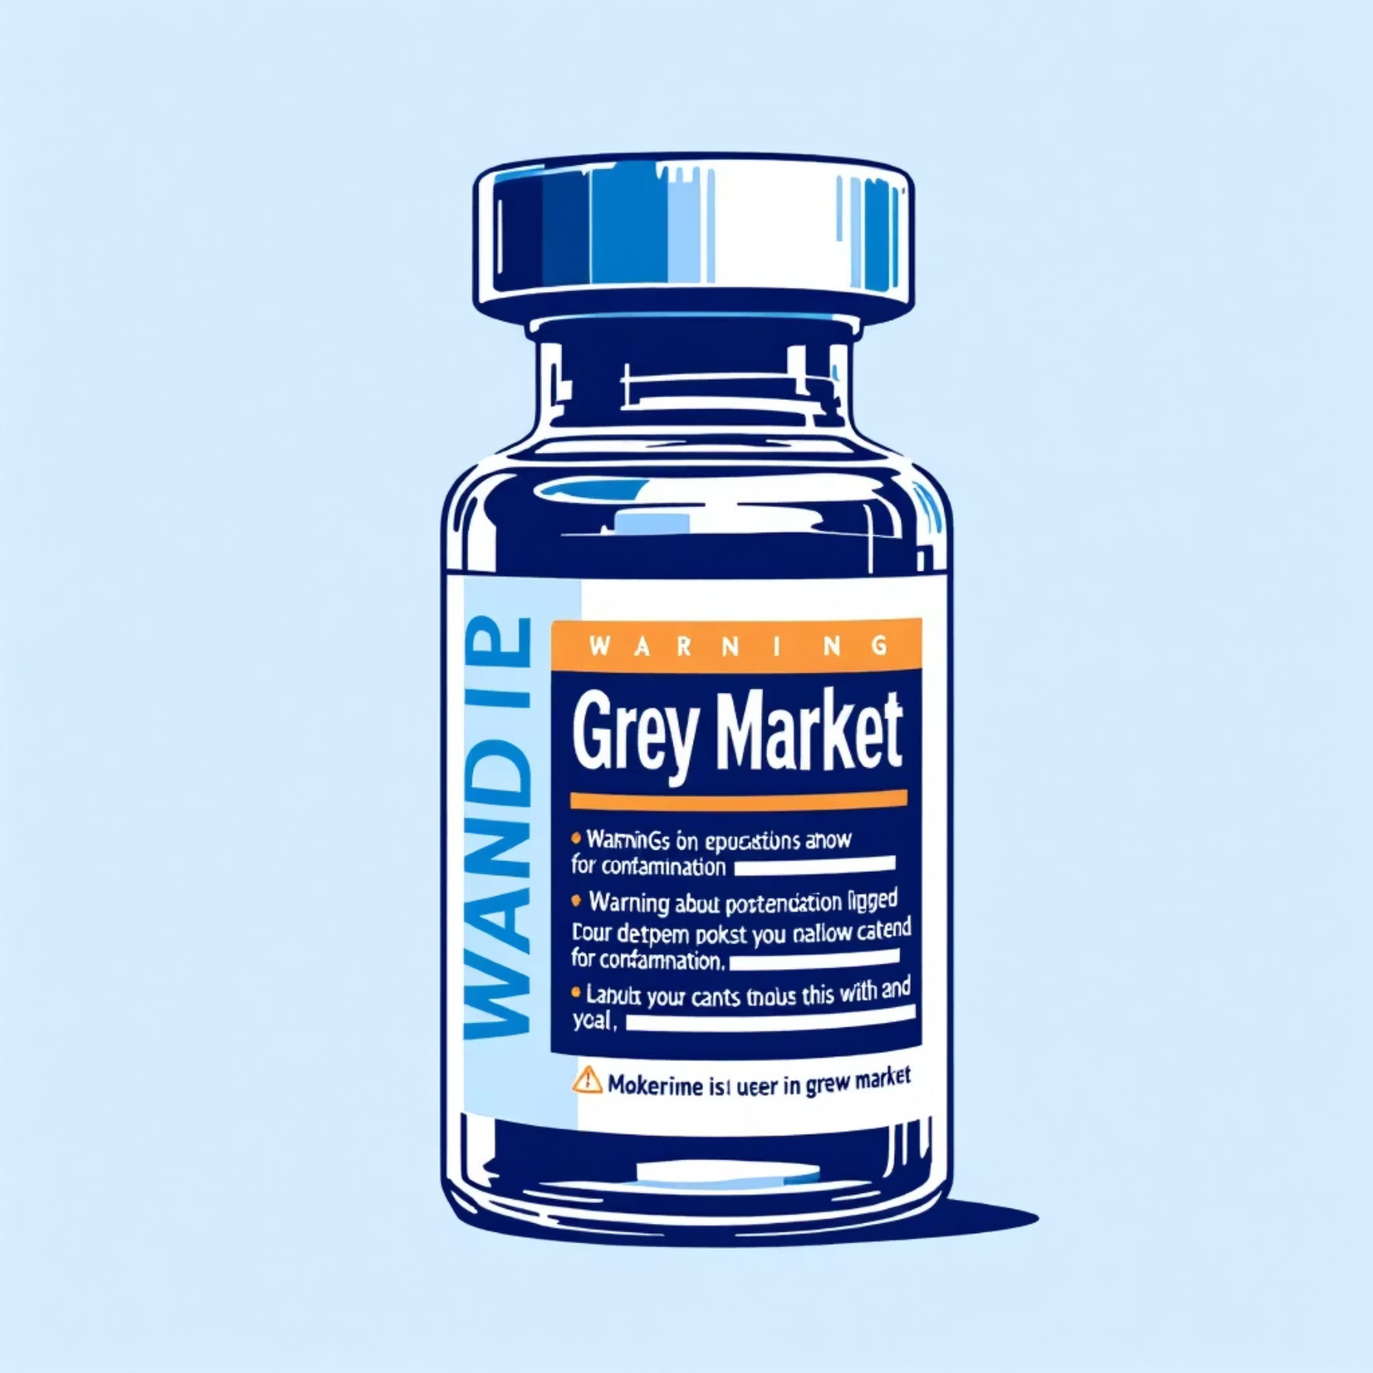
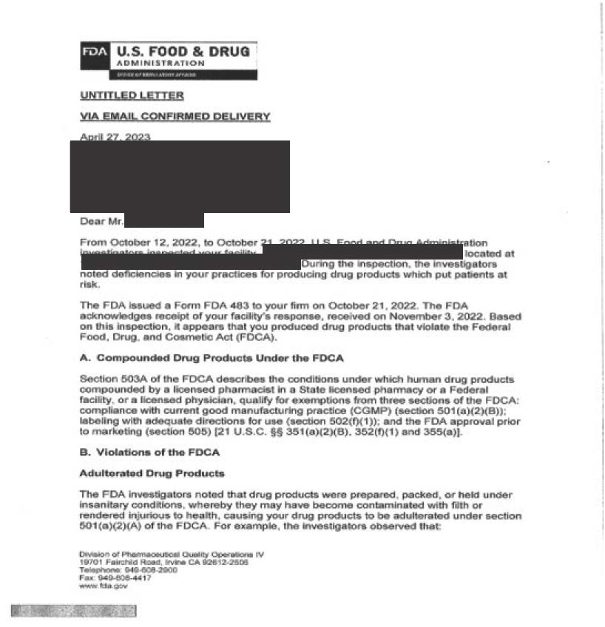

Visualizing the Risks & Enforcement Impact
Enforcement Action483, Untitled Letter, and Warning Letters
Compliance Insight, Inc., 2026
1000+
100%
Products Removed
State Reporting
Unapproved peptide products seized or removed from market annually
FDA reporting Compounding Pharmacy findings to state Boards of Pharmacy
The scope of enforcement demonstrates FDA's commitment to eliminating unsafe peptide products from the marketplace

Slide 9
Immediate Actions After a 483 or Warning Letter
Assemble a cross functional team to review the 483 items and brainstorm Corrective And Preventive Actions (CAPA)
Analyze the specific items noted in the 483 ie directly named procedures, products, or lots
Look beyond the specific items noted for other related areas or products that could be impacted in the same way
Determine corrective actions for the specific and broader approaches
Determine the preventive actions for both the specific and broader approaches
Set reasonable deadlines for completing each corrective and preventive action (CAPA)
Write the response to send to FDA within 15 business days and be certain to address every sentence in the 483 because FDA chose the wording carefully and will expect a complete response
a
Compliance Insight, Inc., 2026

Slide 10

Conclusion: Vigilance & Compliance Are Key
Safe Peptide Use
Intensifying Enforcement
FDA enforcement against unapproved peptides is intensifying at federal and state levels, requiring heightened vigilance
Critical CI Role
Compliance Insight plays a critical role in protecting public health by enforcing regulations and guiding healthcare providers
Continuous Learning
Staying informed on evolving FDA policies and maintaining rigorous compliance protocols ensures patient safety and legal adherence
Collective Impact
Together, we can mitigate risks and uphold the integrity of peptide compounding and use across the healthcare system
Our commitment to regulatory compliance protects patients and strengthens the integrity of pharmaceutical compounding.
Compliance Insight, Inc., 2026

